Slide 1
Introduction to g-suite for education
Biro teknologi informasi

Slide 2
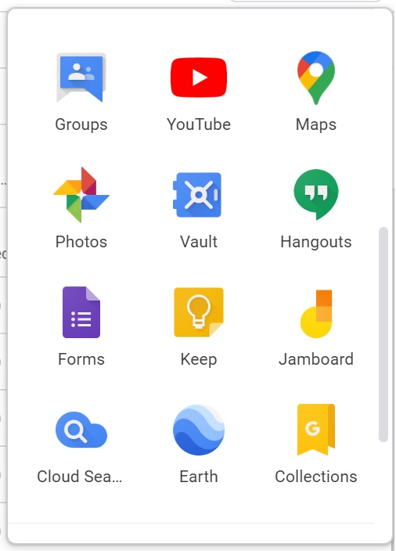
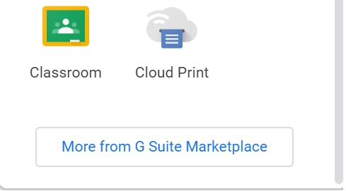
Google apps

Slide 3
G mail

Slide 4
Gmail
 | Exchange Server mail.bakrie.ac.id @bakrie.ac.id | Gmail Bakrie gmail.bakrie.ac.id @bakrie.ac.id | Gmail Personal mail.google.com @gmail.com
Email Storage | 2 GB | Unlimited | 30 GB
Attachment Size - Sending - Receiving | 2 MB 2 MB | 25 MB 50 MB | 25 MB 50 MB
Junk, Spam, Virus Filtering | Yes (Third Party) | Yes (Internal) | Yes Internal)
Outlook Support | Yes | Yes | Yes

Slide 5
Google Drive

Slide 6
Google Drive

Slide 7
Google drive

Slide 8
GDrive

Slide 9
Google hangouts meet
https://www.imore.com/google-meet-vs-zoom-which-group-video-chat-service-do-you-need

Slide 10
Google classroom
Jika mahasiswa sudah di daftarkan ke gsuite maka google classroom dapat di setting supaya hanya menerima mahasiswa yang terdaftar di gsuite

