Slide 1
KULIAH 03
MEMANTAU LAPANGAN PEKERJAAN DAN INFLASI
Setelah mengikuti kuliah ini, Anda diharapkan mampu untuk:
Menjelaskan mengapa pengangguran merupakan masalah dan bagaimana kita mengukur tingkat pengangguran dan indikator-indikator pasar tenaga kerja lainnya;
Menjelaskan mengapa pengangguran terjadi dan mengapa ada bahkan pada saat tingkat pengerjaan penuh (full emplyment);
Menjelaskan mengapa inflasi merupakan masalah dan bagaimana kita mengukur tingkat inflasi.

Slide 3
Setiap bulan, kita memetakan arah pengangguran sebagai ukuran kesehatan ekonomi:
Bagaimana kita mengukur pengangguran?
Data apa yang kita gunakan untuk memonitor pasar tenaga kerja?
Memiliki pekerjaan dengan upah yang layak tidak menentukan standar hidup; namun, biaya hidup juga penting.
Jadi kita juga perlu mengetahui:
Apa itu Indeks Harga Konsumen (IHK)?
Bagaimana cara mengukurnya, dan bagaimana cara menggunakannya

Slide 4
Employment and Unemployment
Ekonomi A.S. adalah mesin pencipta lapangan kerja yang luar biasa. Pada 2008, 146 juta orang memiliki pekerjaan, yaitu 15 juta lebih banyak dari pada tahun 1998 dan 31 juta lebih banyak dari pada tahun 1988. Tetapi tidak semua orang yang menginginkan pekerjaan dapat menemukannya. Pada hari-hari biasa, 7 juta orang menganggur. Selama resesi, jumlah ini naik dan selama tahun boom turun. Paling buruk, selama Depresi Hebat, satu dari setiap empat pekerja menganggur.

Slide 5
Employment and Unemployment
Why Unemployment Is a Problem?
Unemployment results in
Lost production and incomes
Lost human capital
The loss of income is devastating for those who bear it. Employment benefits create a safety net but don’t fully replace lost wages, and not everyone receives benefits.
Prolonged unemployment permanently damages a person’s job prospects by destroying human capital.

Slide 6
Employment and Unemployment
Current Population Survey
The U.S. Census Bureau conducts a monthly population survey to determine the status of the U.S. labor force.
The population is divided into two groups:
1. The working-age population—the number of people aged 16 years and older who are not in jail, hospital, or some other institution
2. People too young to work (under 16 years of age) or in institutional care

Slide 7
Employment and Unemployment
The working-age population is divided into two groups:
1. People in the labor force
2. People not in the labor force
The labor force is the sum of employed and unemployed workers.

Slide 8
Employment and Unemployment
To be counted as unemployed, a person must be in one of the following three categories:
1. Without work but has made specific efforts to find a job within the previous four weeks
2. Waiting to be called back to a job from which he or she has been laid off
3. Waiting to start a new job within 30 days
Notes:
Positive versus normative. Unemployment is an emotionally charged subject and is a good one for reinforcing the important point that economics is positive in contrast to normative. The economist’s job is to try to explain why unemployment exists, what determines its rate, and assess the efficient amount of unemployment.
The benefits of unemployment. It comes as a shock to most students that unemployment has benefits as well as costs and that there is an efficient amount of unemployment that is greater than zero. (Note that this statement is positive!) You might like to spend a bit of class time on this topic. If you do, here are some ideas about what to do:
A good way to introduce the idea that unemployment brings benefits is to think about the unemployment of things rather than people. Look around the campus and notice all the unemployed automobiles in the parking lots/stations. Notice the unemployed class rooms early in the morning and late at night. Notice the unemployed coffee shop seats at peak lecture times. Look around the city and notice all the unemployed automobiles in the car sales lots. Try to make a reservation at any of the hotels in the city and notice that you can almost always get a room—hence, lots of unemployed hotel rooms.
[Continued on the note for the next slide.]

Slide 9
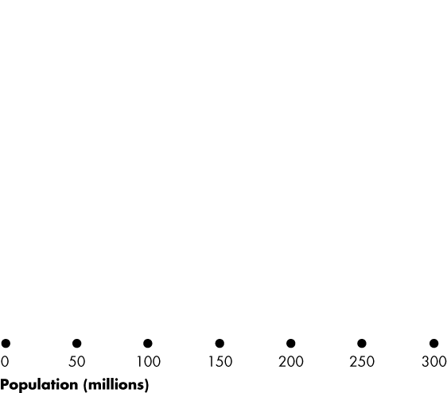
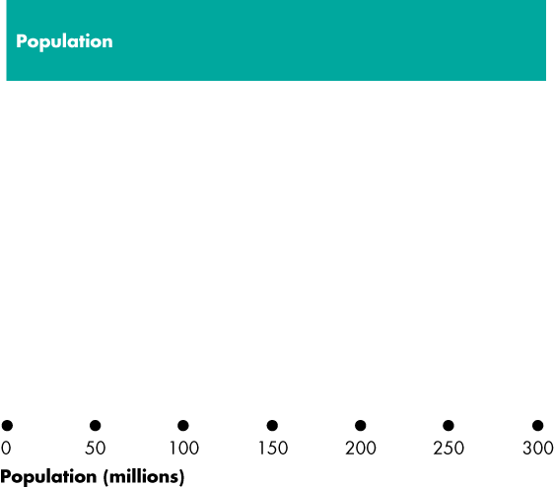
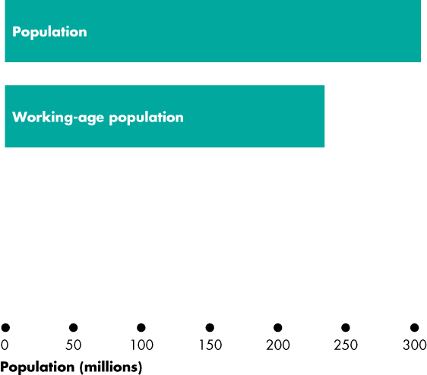
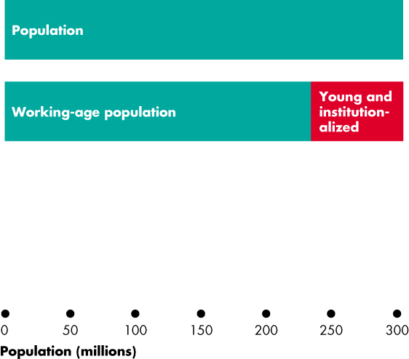
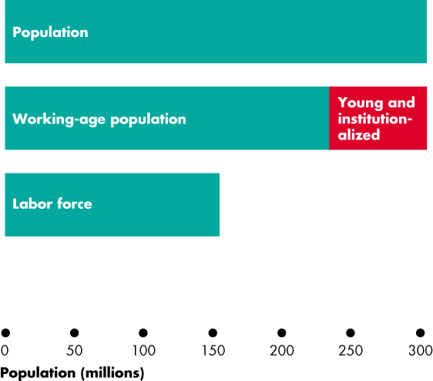
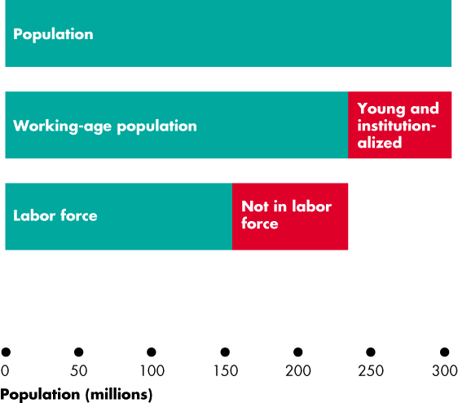
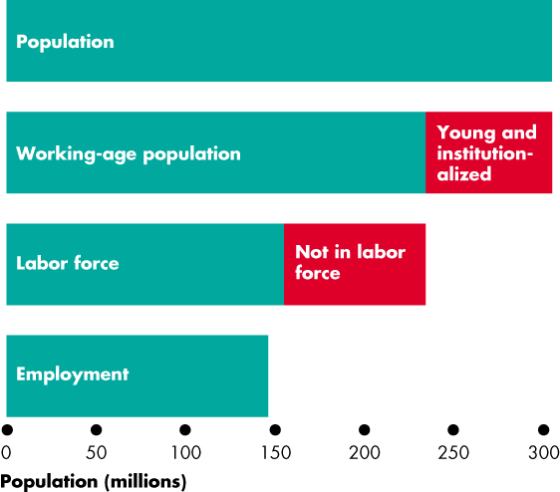
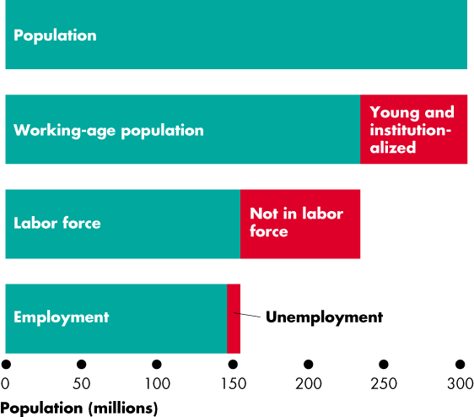
Employment and Unemployment
Figure 22.1 shows the labor force categories.
Population: 304.5 million
Working-age population: 233.8 million
Labor force: 154.6 million
Employment: 145.8 million
Unemployment: 8.8 million
Notes:
Now ask: does all this unemployment bring benefits? The students quickly see that it would be very costly to organize rental markets in which cars don’t sit idle all day, and so on.
Now ask: do the same ideas apply to unemployed people? (Be sure to be compassionate about the misery that unemployment can bring. You are not claiming that it is not costly. You’re trying to identify the benefits, if any.)
You’ll quickly get your students to see that imagining an economy without any unemployment is nearly impossible. If consumers are free to change their decisions about what they want to buy, some goods and services must fall out of favor when others come into favor. The firms making the unfavoured products fall on hard times and often their workers are fired or laid off.
Sure, these laid off workers could start work right away, cleaning shoes or selling flowers at intersections. But they are better off (in their own opinion) being frictionally unemployed and searching for new jobs. To eliminate this source of unemployment we would need to forbid consumers from changing their buying plans or insist that no one remain idle and get on with doing any job even if it doesn’t earn a wage.
Note that if this is how we ran our economy, we’d still be using coal-fired stoves and the pony express, and we’d be wearing coonskin caps. There would be no McDonald’s, Federal Express, or Nike shoes.

Slide 10
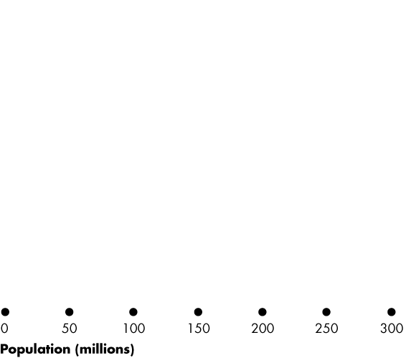
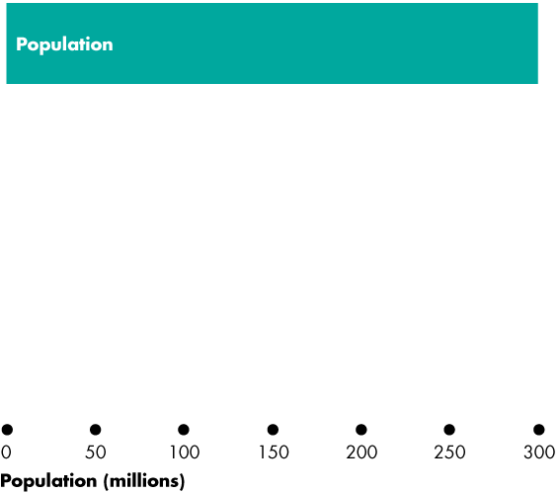
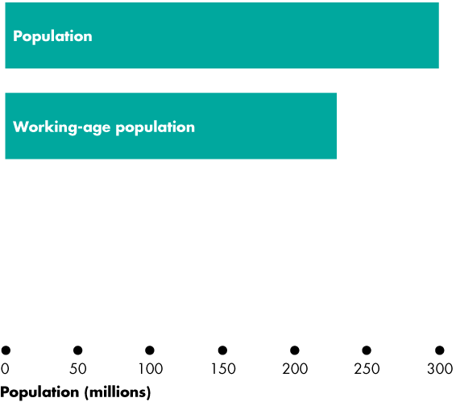
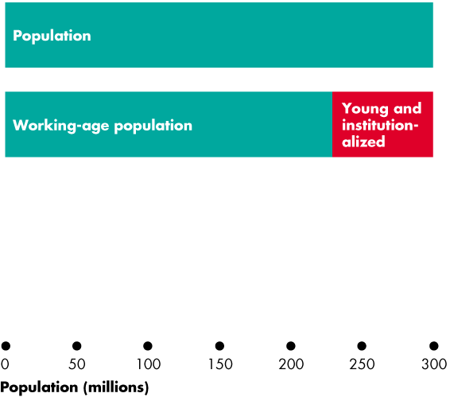
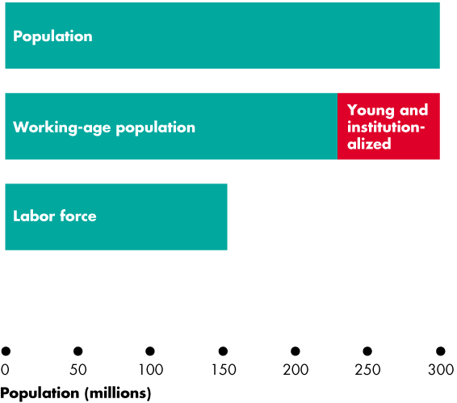
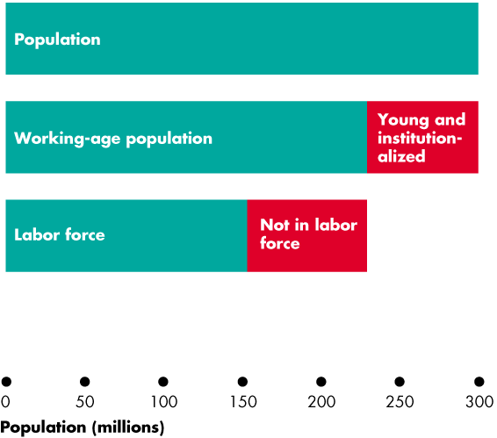
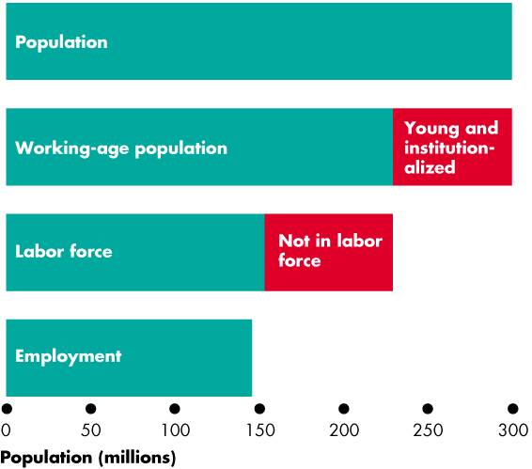
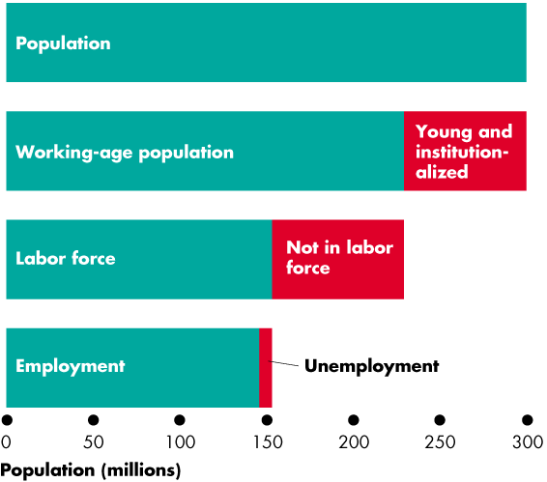

Slide 11
Employment and Unemployment
Three Labor Market Indicators
The unemployment rate
The employment-to-population ratio
The labor force participation rate

Slide 12
Employment and Unemployment
The Unemployment Rate
The unemployment rate is the percentage of the labor force that is unemployed.
The unemployment rate is (Number of people unemployed ÷ labor force) × 100.
In 2008, the labor force was 154.6 million and 8.8 million were unemployed, so the unemployment rate was 5.7 percent.
The unemployment rate reaches its peaks during recessions.

Slide 13
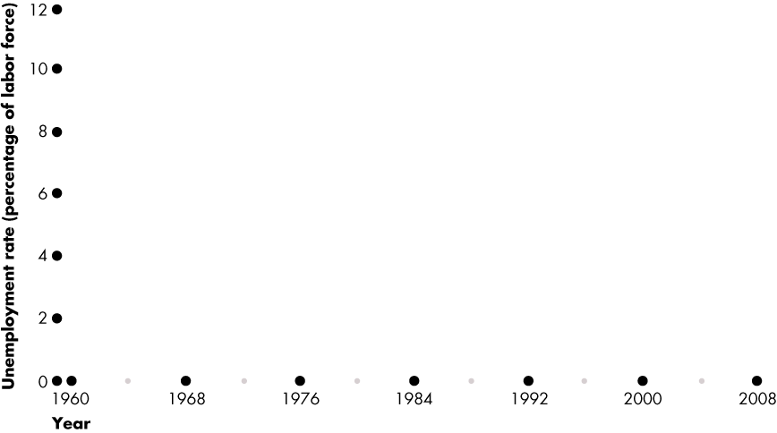
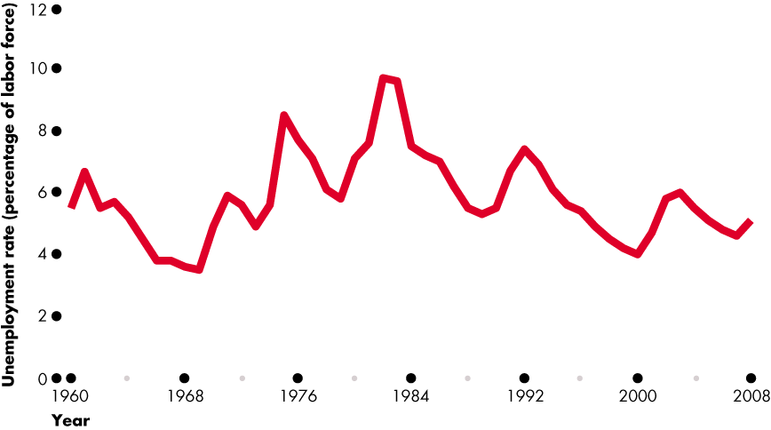
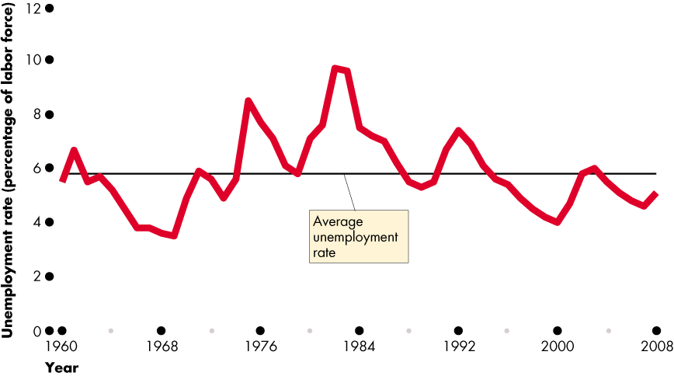
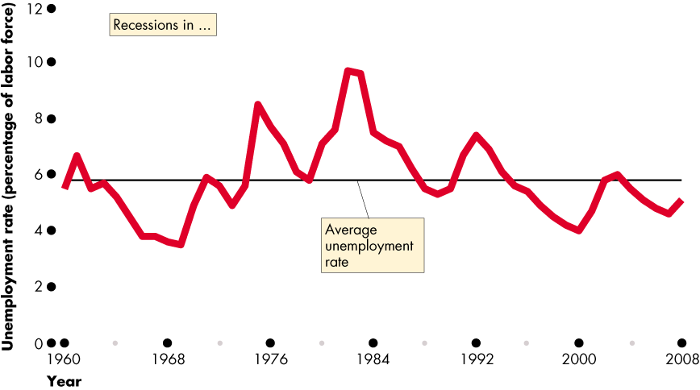
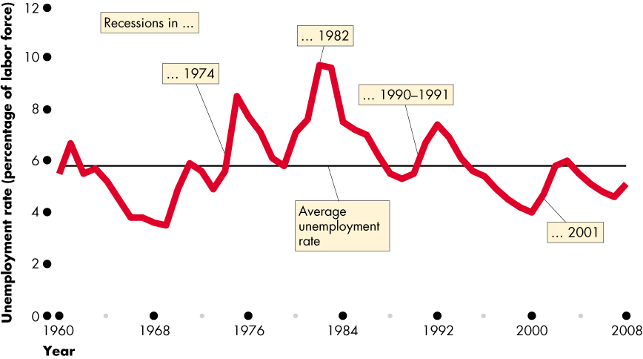
Employment and Unemployment
Figure 22.1 shows the unemployment rate: 1960–2008.
The unemployment rate increases in a recession.

Slide 15
Employment and Unemployment
The Employment-to-Population Ratio
The employment-to-population ratio is the percentage of the working-age population who have jobs.
The employment-to-population ratio is (Employment ÷ Working-age population) × 100.
In 2008, the employment was 145.8 million million and the working-age population was 233.8 million.
The employment-to-population ratio was 62.4 percent.

Slide 16
Employment and Unemployment
The Labor Force Participation Rate
The labor force participation rate is the percentage of the working-age population who are members of the labor force.
The labor force participation rate is (Labor force ÷ Working-age population) × 100.
In 2008, the labor force was 154.6 million and the working-age population was 233.8 million.
The labor force participation rate was 66.1 percent.

Slide 17
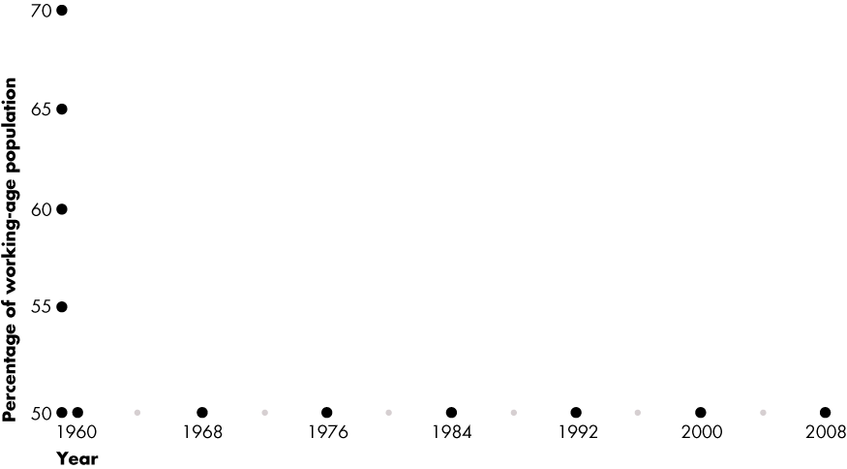
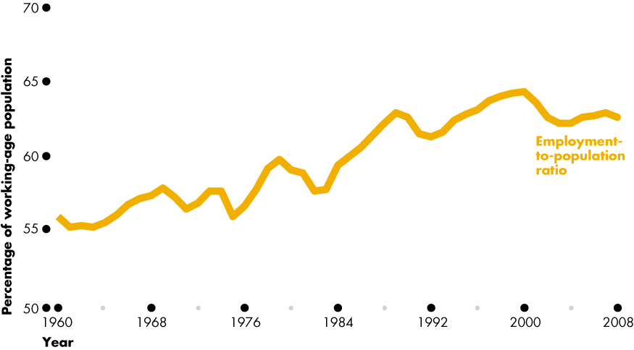
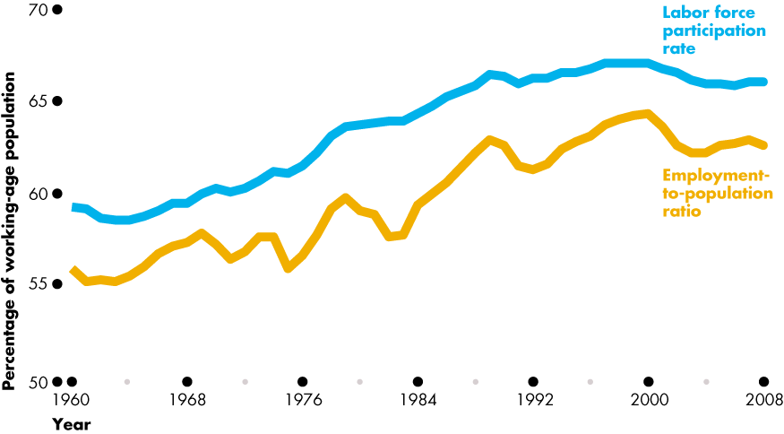
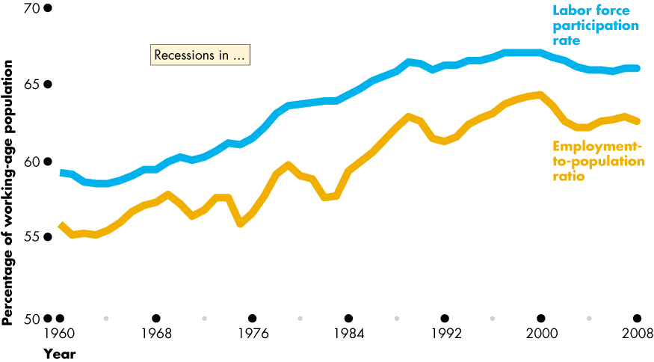
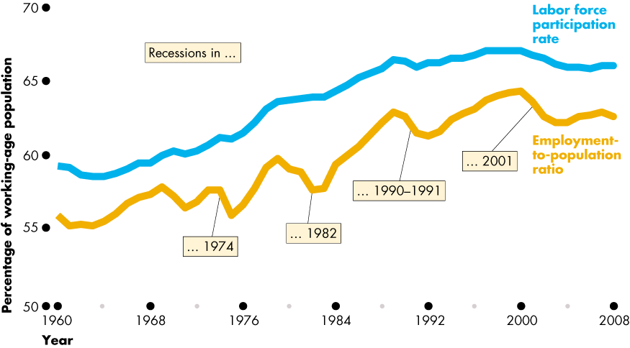
Employment and Unemployment
Figure 22.3 shows the labor force participation rate and employment-to-population ratio both have upward trends before 2000 and no trend after 2000.

Slide 19
Unemployment and Full Employment
The purpose of the unemployment rate is to measure the underutilization of labor resources.
It is an imperfect measure for two sets of reasons:
It excludes some underutilized labor
Some unemployment is unavoidable—is “natural.”

Slide 20
Unemployment and Full Employment
Two types of underutilized labor that are excluded from the official unemployment measure are
Marginally attached workers
Part-time workers who want full-time jobs
A marginally attached worker is a person who currently is neither working nor looking for work but has indicated that he or she wants and is available for a job and has looked for work sometime in the recent past.
A discouraged worker is a marginally attached worker who has stopped looking for a job because of repeated failure to find one.

Slide 21
Unemployment and Full Employment
Many part-time workers want to work part time.
But some part-time workers would like fulltime jobs and can’t find them.
In the official statistics, these workers are called economic part-time workers and they are partly unemployed.
In August 2008, when the official unemployment rate was 6.1 percent, the economic part-time unemployment rate was 3.7 percent.
The overall unemployment rate including marginally attached workers was 10.7 percent of the labor force.

Slide 22
Unemployment and Full Employment
“Natural” Unemployment
Unemployment arises from job search activity.
There is always someone without a job who is searching for one, so there is always some unemployment.
The key reason why there is always someone who is searching for a job is that the economy is a complex mechanism that is always changing—it is a churning economy.

Slide 23
Unemployment and Full Employment
The Churning Economy
Some of the change in the churning economy comes from the transitions that people make through the stages of life:
From being in school to finding a job, to working, perhaps to becoming unhappy with a job and looking for a new one, and finally, to retiring from full-time work.
In the United States in 2008, more than 3 million new workers entered the labor force and more than 2.5 million workers retired.

Slide 24
Unemployment and Full Employment
The Sources of Unemployment
People become unemployed if they
1. Lose their jobs and search for another job.
2. Leave their jobs and search for another job.
3. Enter or reenter the labor force to search for a job.
People end a spell of unemployment if they
1. Are hired or recalled.
2. Withdraw from the labor force.
Notes:
Labor turnover and unemployment. Ask in class how many students have jobs and how many of them have changed their job within the last 12 months. You can now discuss the constant movement in and out of the labor market and the consequence that frictional unemployment will always exist.

Slide 25
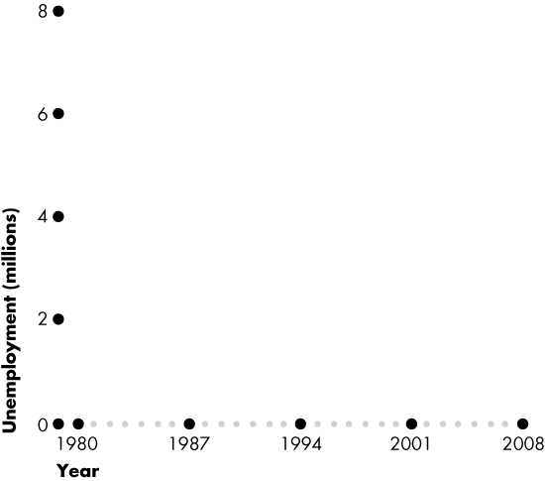
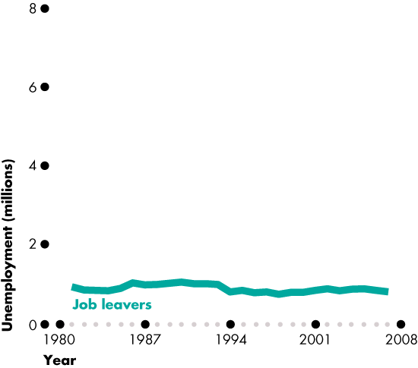
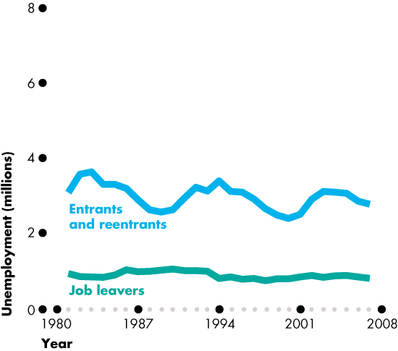
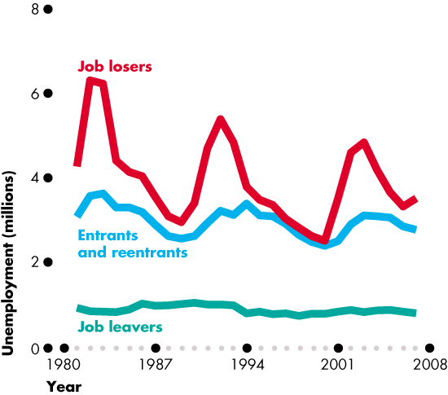
Unemployment and Full Employment
Figure 22.4 shows unemployment by reason.
Job leavers are the smallest group.
Entrants and reentrants are the next smallest group.
Job losers are the largest and the most cyclical group.

Slide 27
Unemployment and Full Employment
Frictions, Structural Change, and Cycles
Unemployment can be classified into three types:
Frictional
Structural
Cyclical
Notes:
Identifying frictional, structural, and cyclical unemployment. Ask your class if anyone they know has been laid off. Then discuss whether losing a job creates frictional, structural, or cyclical unemployment. Look at your local examples. If you live in a steel-producing area, for example, you can talk about local structural unemployment arising from the closing of a steel manufacturer due to international competition. For cyclical unemployment, ask students how they think the business cycle and cyclical unemployment is related to full-time enrollments at higher education institutions. Students often don’t think there is any relationship. But nationally during a recession, the growth rate of full-time enrollments increases. Ask students if they can explain this relationship. The answer is that during a recession and due to the increase in cyclical unemployment, the opportunity cost of school decreases. This is a great way to keep students thinking about marginal benefits and costs.

Slide 28
Unemployment and Full Employment
Frictional unemployment is unemployment that arises from normal labor market turnover.
The creation and destruction of jobs requires that unemployed workers search for new jobs.
Increases in the number of people entering and reentering the labor force and increases in unemployment compensation raise frictional unemployment.

Slide 29
Unemployment and Full Employment
Structural unemployment is unemployment created by changes in technology and foreign competition that change the skills needed to perform jobs or the locations of jobs.
Structural unemployment lasts longer than frictional unemployment.
Cyclical unemployment is the fluctuating unemployment over the business cycle.

Slide 30
Unemployment and Full Employment
What is “Natural Unemployment”?
The unemployment rate at full employment is called the natural unemployment rate.
Full employment occurs when there is no cyclical unemployment or, equivalently, when all unemployment is frictional and structural.
The natural unemployment rate was high during the early 1980s but has gradually decreased.

Slide 31
Unemployment and Full Employment
Real GDP and Unemployment Over the Cycle
Potential GDP is the quantity of real GDP produced at full employment.
Potential GDP corresponds to the capacity of the economy to produce output on a sustained basis.
Real GDP minus potential GDP is the output gap.
Over the business cycle, the output gap fluctuates and the unemployment rate fluctuates around the natural unemployment rate.

Slide 32
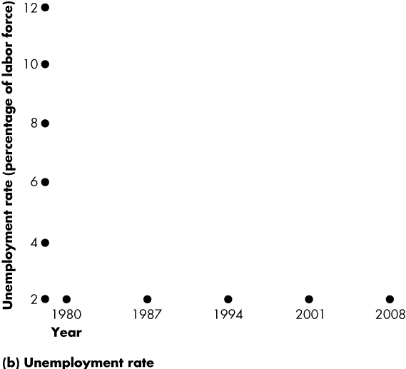
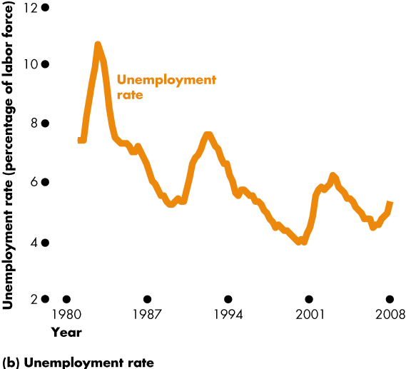
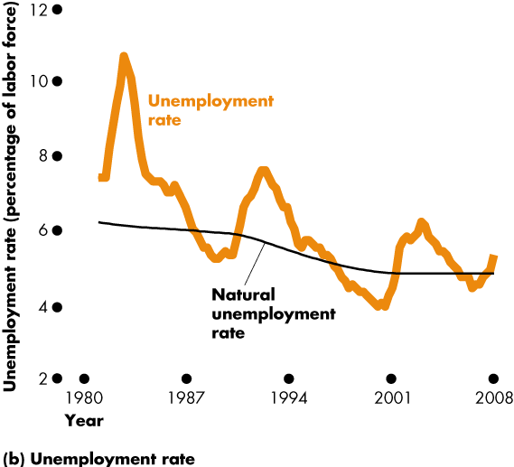
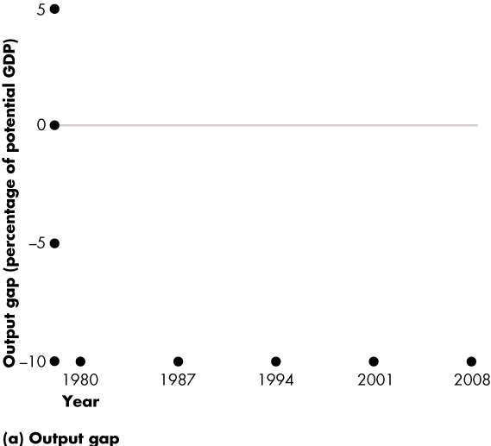
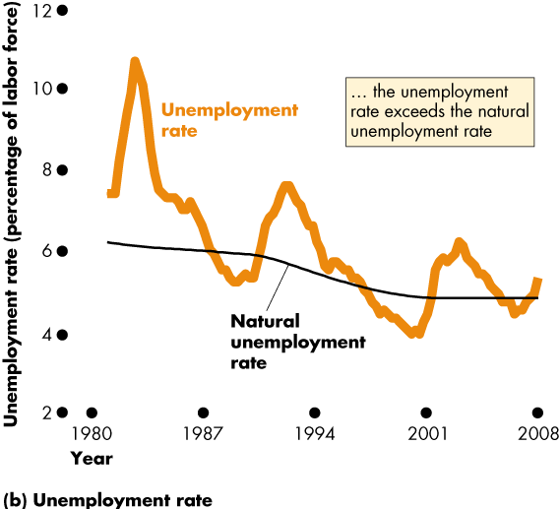
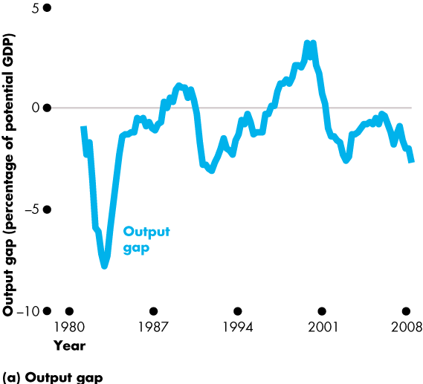
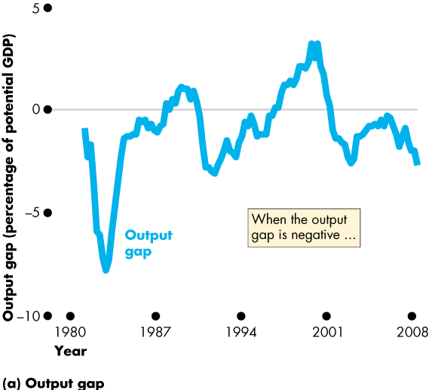
Unemployment and Full Employment
Figure 22.5 shows the output gap and the fluctuations of unemployment around the natural rate.

Slide 35
Price Level and Inflation
The price level is the average level of prices and the value of money.
The inflation rate is the annual percentage change in the price level.
We are interested in the price level because we want to
Measure the inflation rate
Distinguish between real and nominal values of economic variables.
Notes:
The CPI—an average. It is important for students to understand that the CPI is based on the average expenditure basket, not the expenditure pattern of any given household. Displaying the detailed press releases on the Statistics Canada Web site helps make this point very forcibly: students often do not realize until they see the numbers that the CPI must include both costs of owning a house and costs of renting one; costs of buying a car and costs of public transportation; and so on.

Slide 36
Price Level and Inflation
Why Inflation Is a Problem
Inflation is a problem for many reasons, but the main one is that once it takes hold, it is unpredictable.
Unpredictable inflation is a problem because it
Redistributes income and wealth
Diverts resources from production

Slide 37
Price Level and Inflation
Unpredictable changes in the inflation rate redistribute income in arbitrary ways between employers and workers and between borrowers and lenders.
A high inflation rate is a problem because it diverts resources from productive activities to inflation forecasting.
From a social perspective, this waste of resources is a cost of inflation.
At its worse, inflation becomes hyperinflation—an inflation rate that is so rapid that workers are paid twice a day because money loses its value so quickly.

Slide 38
Price Level and Inflation
The Consumer Price Index
The Consumer Price Index, or CPI, measures the average of the prices paid by urban consumers for a “fixed” basket of consumer goods and services.
Notes:
The CPI—an average. It is important for students to understand that the CPI is based on the average expenditure basket, not the expenditure pattern of any given household. Displaying the detailed press releases on the BLS Web site helps make this point very forcibly: students often do not realize until they see the numbers that the CPI must include both costs of owning a house and costs of renting one; costs of buying a car and costs of public transportation; and so on.

Slide 39
Price Level and Inflation
Reading the CPI Numbers
The CPI is defined to equal 100 for the reference base period.
Currently, the reference base period is 1982−1984.
That is, for the average of the 36 months from January 1982 through December 1984, the CPI equals 100.
In July 2008, the CPI was 220.
This number tells us that the average of the prices paid by urban consumers for a fixed basket of goods was 120 percent higher in 2008 than it was during 1982−1984.

Slide 40
Price Level and Inflation
Constructing the CPI
Constructing the CPI involves three stages:
Selecting the CPI basket
Conducting a monthly price survey
Calculating the CPI

Slide 41
Price Level and Inflation
The CPI Basket
The CPI basket is based on a Consumer Expenditure Survey, which is undertaken infrequently.
The CPI basket today is based on data collected in the Consumer Expenditure Survey of 2001−2002.
The CPI basket contains 80,000 goods.

Slide 42
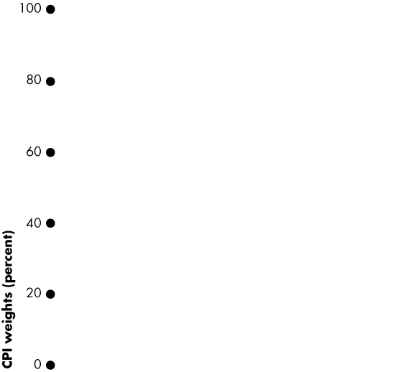
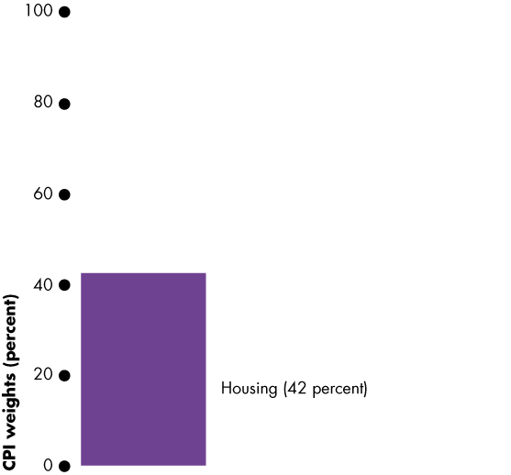
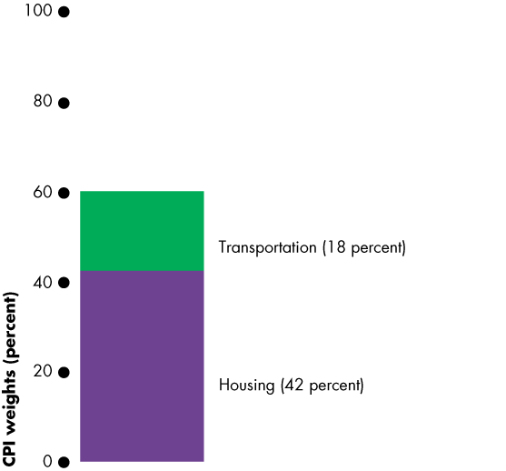
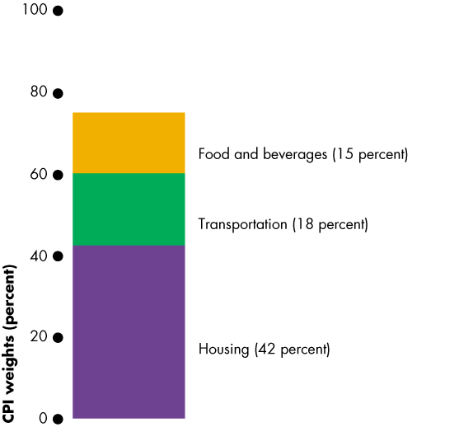
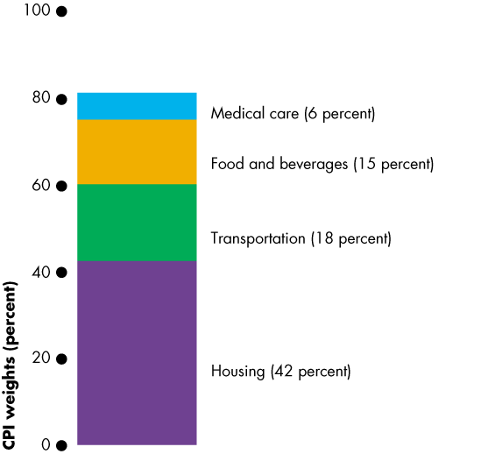
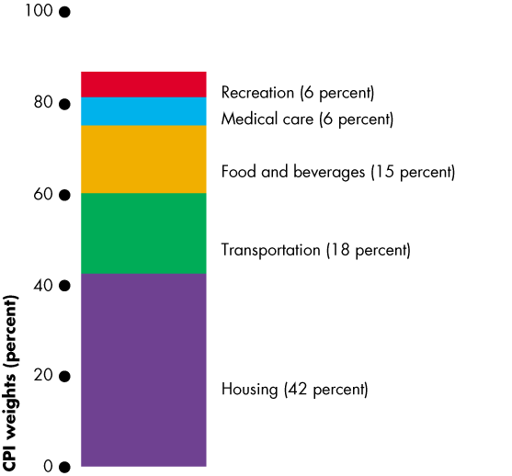
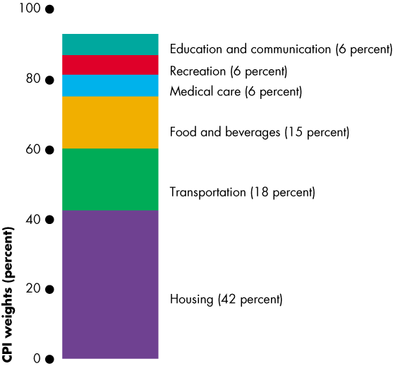
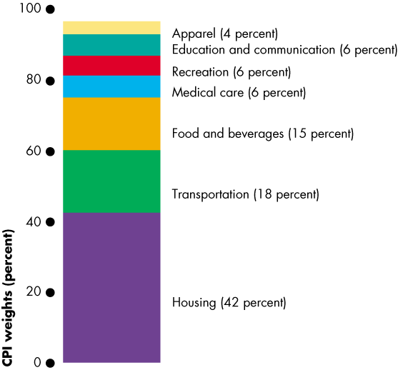
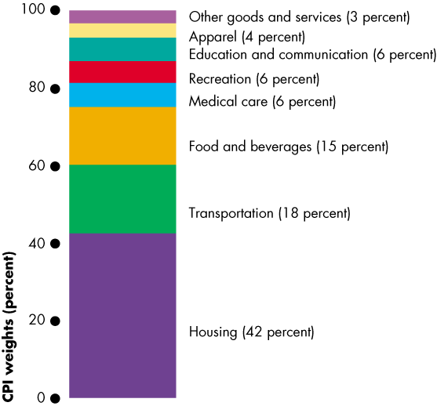
Price Level and Inflation
Figure 22.6 illustrates the CPI basket.
Housing is the largest component.
Transportation and food and beverages are the next largest components.
The remaining components account for 25 percent of the basket.
Notes:
Making the CPI personal. If you have time (or want to make time) you can get your students to construct their own CPI basket. Each student makes a statement of her/his expenditure in the same categories as the CPI basket in the figure on this slide. Students then compare their expenditure patterns to the average of the CPI basket.

Slide 44
Price Level and Inflation
The Monthly Price Survey
Every month, BLS employees check the prices of 80,000 goods on 30 metropolitan areas.
Calculating the CPI
1. Find the cost of the CPI basket at base-period prices.
2. Find the cost of the CPI basket at current-period prices.
3. Calculate the CPI for the current period.

Slide 45
Price Level and Inflation
Let’s work an example of the CPI calculation.
In a simple economy, people consume only oranges and haircuts.
The CPI basket is 10 oranges and 5 haircuts.
The table also shows the prices in the base period.
The cost of the CPI basket in the base period was $50.

Slide 46
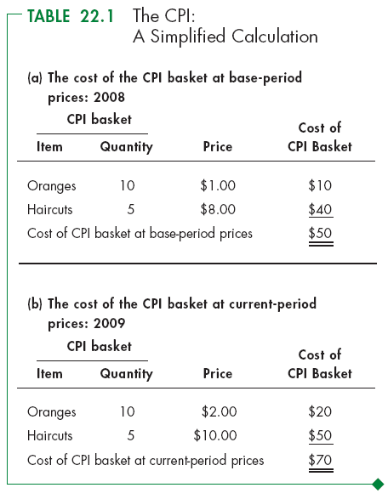
Price Level and Inflation
Table 22.1(b) shows the fixed CPI basket of goods.
It also shows the prices in the current period.
The cost of the CPI basket at current-period prices is $70.

Slide 47
Price Level and Inflation
The CPI is calculated using the formula:
CPI = (Cost of basket at current-period prices ÷ Cost of basket at base-period prices)  100.
Using the numbers for the simple example,
CPI = ($70 ÷ $50)  100 = 140.
The CPI is 40 percent higher in the current period than it was in the base period.

Slide 48
Price Level and Inflation
Measuring the Inflation Rate
The major purpose of the CPI is to measure inflation.
The inflation rate is the percentage change in the price level from one year to the next.
The inflation formula is:
Inflation rate = [(CPI this year – CPI last year) ÷ CPI last year] × 100.

Slide 49
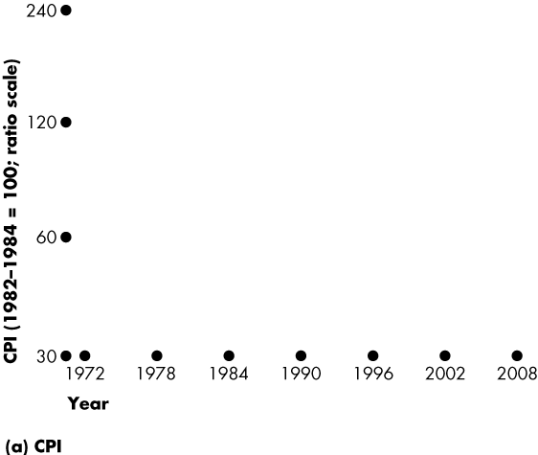
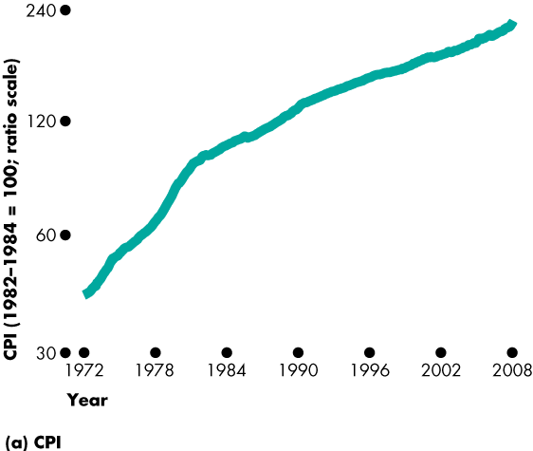
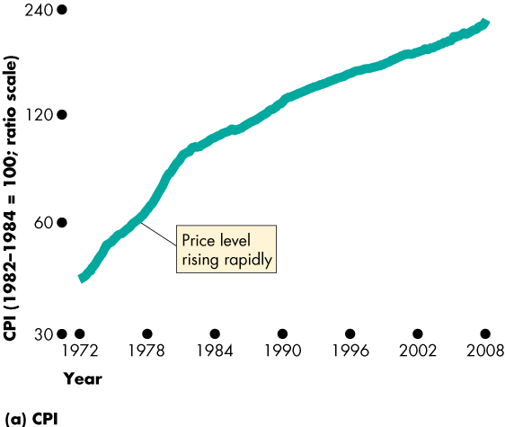
Price Level and Inflation
Figure 22.7 shows the relationship between the price level and inflation.
Figure 22.7(a) shows the CPI from1972 to 2008.

Slide 50
Price Level and Inflation
Figure 22.7(b) shows that the inflation rate is
High when the price level is rising rapidly and
Low when the price level is rising slowly.

Slide 52
Price Level and Inflation
The Biased CPI
The CPI might overstate the true inflation for four reasons:
New goods bias
Quality change bias
Commodity substitution bias
Outlet substitution bias
Notes:
CPI biases—concrete illustrations. New goods bias can be illustrated with MP3 music rather than CDs; quality change with computers and cars; commodity substitution with movies versus videos; and outlet substitution by the growth of Wal-mart, Target, and shopping on the internet.

Slide 53
Price Level and Inflation
New Goods Bias
New goods that were not available in the base year appear and, if they are more expensive than the goods they replace, they put an upward bias into the CPI.
Quality Change Bias
Quality improvements occur every year. Part of the rise in the price is payment for improved quality and is not inflation.
The CPI counts all the price rise as inflation.

Slide 54
Price Level and Inflation
Commodity Substitution Bias
The market basket of goods used in calculating the CPI is fixed and does not take into account consumers’ substitutions away from goods whose relative prices increase.
Outlet Substitution Bias
As the structure of retailing changes, people switch to buying from cheaper sources, but the CPI, as measured, does not take account of this outlet substitution.

Slide 55
Price Level and Inflation
Some Consequences of the Bias
The bias in the CPI
Distorts private contracts.
Increases government outlays (close to a third of federal government outlays are linked to the CPI).
Biases estimates of real earnings.
A bias of 1 percent is small but over a decade adds up to almost $1 trillion of additional expenditure.

Slide 56
Price Level and Inflation
Alternative Price Indexes
Alternative measures of the price level are
Chained CPI
Personal consumption expenditure deflator
GPD deflator

Slide 57
Price Level and Inflation
Personal Consumption Expenditure Deflator
The PCE deflator equals
(Nominal consumption expenditure ÷ Real consumption expenditure)  100
PCE deflator is a broader measure of the price level than the CPI because it uses all personal consumption expenditures.
GDP deflator is like the PCE deflator except it includes the prices of all goods and services.

Slide 58
Price Level and Inflation
Core Inflation Rate
The core inflation rate is the CPI inflation rate excluding the volatile elements (of food and fuel).
The core inflation rate attempts to reveal the underlying inflation trend.

Slide 60
Price Level and Inflation
The Real Variables in Macroeconomics
We can use the GPD deflator to deflate nominal variables to find their real values.
For example,
Real wage rate = (Nominal wage rate ÷ GDP deflator)  100
But not the real interest rate! It is different.

